Slide 1

Logic & Life-Cycle
Events, Listeners, and Persistent Storage

Slide 2


Mastery Agenda
Module 1: The Event System
Module 2: Browser Persistence
Decoding the DOM interaction model, propagation mechanics, and efficient delegation strategies for high-performance UIs.
Architecting client-side data storage, security boundaries, and the JSON serialization bridge for state management.

Slide 3
The Event System
Orchestrating user intent and browser response.

Slide 4


What are DOM Events?
Interaction Signals
Events are notifications that occur in the browser window. They range from physical inputs (mouse clicks) to lifecycle changes (page load) and logical transitions (animations).
JavaScript captures these signals to trigger specific logic, enabling the "Reactive" nature of the modern web.

Slide 5
Mechanism of Listeners
Passive Observability: Elements wait silently until a target event occurs.
Function Binding: Logic is attached to elements via the addEventListener method.
Multi-Binding: A single element can respond to multiple events or have multiple listeners for one event.

Slide 6

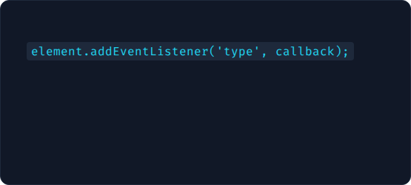
EventListener Syntax
Essential Arguments
Standard Call
1. Type: The event string (e.g., 'click'). 2. Callback: The function to execute. 3. Options: Boolean or object for capture/once settings.
This method is preferred over inline onclick attributes as it maintains the separation of concerns.

Slide 7





Mouse Interaction Events
Click & DblClick
Hover States
Movement
Triggered on full press and release cycles.
mouseenter and mouseleave track entry into element boundaries.
mousemove triggers continuously as the cursor travels over a target.

Slide 8



Keyboard & Input Logic
Key Sequencing
Input Tracking
Focus Shifts
keydown, keypress, and keyup track the typing life-cycle.
input triggers on every character change, ideal for live searching.
focus and blur detect when a user enters or leaves a field.

Slide 9
Form Life-Cycle Events
Working with forms requires intercepting the submit event. This is the single most critical event for data handling.
Unlike a click on a button, the submit event on a captures enter-key presses and button interactions collectively.

Slide 10
The Event Object Structure
100+
Metadata Properties
The browser passes a hidden object to every callback containing the context of the event (Target, Coordinates, Time, and Key Codes).

Slide 11

Preventing Defaults
Browsers have built-in behaviors, such as refreshing the page on form submission or following a link URL.
e.preventDefault() is the tool used to suppress these behaviors, allowing JavaScript to handle the logic manually without a page reload.

Slide 12
The Propagation Phases
1. Capture
2. Target
3. Bubbling
Success
Flowing from Document down to Target.
The event reaches the interaction point.
Flowing back up to the Document root.
Listener execution occurs.

Slide 13
Breaking the Chain
"
"Propagation is the heartbeat of DOM architecture, but StopPropagation is the surgical tool to prevent unwanted side effects."
Use e.stopPropagation() to prevent an event from triggering listeners on parent containers.

Slide 14
Event Delegation Overview
The Challenge
The Solution
Adding listeners to 1,000 list items creates massive memory overhead and fails to account for items added dynamically via the script.
Attach one listener to the parent container and use e.target to identify which child was interacted with. This is efficient and future-proof.

Slide 15
Delegation Implementation
1. Identify a stable parent container in the DOM.
2. Use e.target.matches('.child-selector') to filter clicks.
3. Execute logic only when the filter condition is met.

Slide 16
Memory Management
Leaving event listeners on destroyed elements leads to memory leaks in complex Single Page Applications (SPAs).
Use removeEventListener with a named function reference to properly clean up after a component unmounts.
target.removeEventListener('click', namedFunc);

Slide 17
Local Storage API
Architecting persistence in the stateless browser.

Slide 18
Permanent Persistence
Storage Mechanism
Reliability
Local Storage allows applications to store key-value pairs locally in the user's browser with no expiration date.
Data remains intact after the browser tab is closed, the application is refreshed, or the operating system is rebooted.

Slide 19
Local vs Session Storage
Local (Permanent)
Session (Transient)
Persists globally across the domain. Shared between all tabs. Ideal for settings and preferences.
Unique to the specific tab. Cleared immediately when the tab is closed. Ideal for sensitive form data.

Slide 20






Core Storage Methods
setItem()
getItem()
removeItem()
Creates or updates a key-value entry.
Retrieves a string value by its key.
Deletes a specific entry.

Slide 21

The String Constraint
Everything is Text
Web Storage API only accepts strings. If you try to store a number, boolean, or array directly, the browser will force-convert it to a string, often resulting in [object Object].
To store complex data, we must use the JSON serialization bridge.

Slide 22
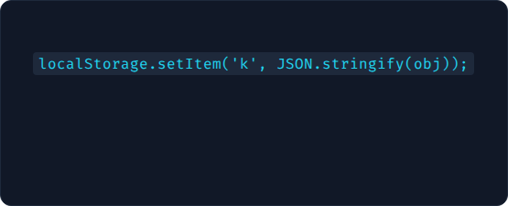
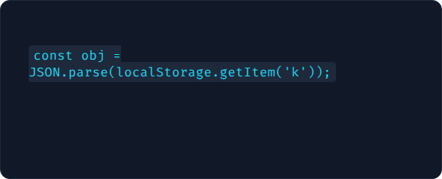
JSON Serialization Bridge
Storing (Stringify)
Retrieving (Parse)
Converts your live JS object into a flat string of text for storage.
Reconstructs the string back into a functional JavaScript object.

Slide 23
Storage Limits & Quotas
5MB
Standard Domain Limit
Exceeding this limit throws a QuotaExceededError. Always manage your data footprints responsibly.

Slide 24


Security Constraints
Local Storage is vulnerable to Cross-Site Scripting (XSS). Any script running on your domain can read the storage. Never store secrets, passwords, or session tokens in plain text storage.

Slide 25
Same-Origin Security
Domain Bound: site.com cannot see other.com storage.
Protocol Bound: http cannot see https data.
Subdomain Bound: api.site.com is distinct from site.com.

Slide 26

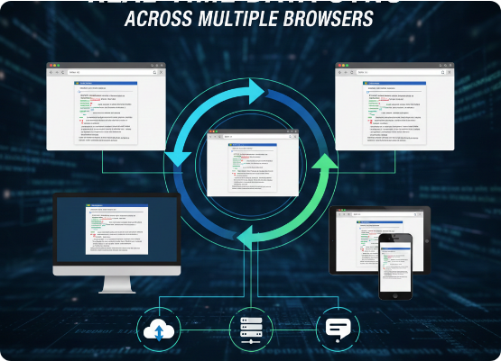
Multi-Tab Synchronization
When storage is updated in one tab, the browser fires a storage event in all other tabs of the same domain.
This allows your application to sync UI states (like theme changes or cart updates) across multiple open windows instantly.

Slide 27

Case Study: Theme Toggle
1. Check storage on load: const theme = localStorage.getItem('theme');
2. Apply saved class to .
3. On toggle click: Update UI and localStorage.setItem('theme', newTheme);

Slide 28



Case Study: Form Auto-Save
1. Listener
2. Persistence
3. Recovery
Attach input event to the form fields.
Stringify the field data into Local Storage every 500ms.
Populate inputs from storage if a user accidentally refreshes.

Slide 29
Performance Best Practices
Limit Reads/Writes: Storage operations are synchronous and can block the main thread.
Namespace Keys: Use prefixes like myapp_settings to avoid conflicts.
Batch Updates: Save objects instead of calling setItem for every individual field.

Slide 30
Q&A
Mastering Browser Events and Persistence
developer.mozilla.org/Web/API/Storage_API

